Slide 1
System and Cyber Security
L. Budi Handoko, M.Kom. (handoko@dosen.dinus.ac.id /
handoko@dsn.dinus.ac.id)
Dian Nuswantoro University

Slide 2
Ethical Hacking
also known as penetration testing or white-hat hacking, involves the same tools, tricks, and techniques that hackers use, but with one major difference that Ethical hacking is legal

Slide 3
Types of Hackers
Black Hat Hacker
White Hat Hacker
Grey Hat Hacker

Slide 4
What’s The Different
Black Hat
White Hat
Grey Hat
A black hat hackers or crackers are individuals with extraordinary computing skills, resorting to malicious or destructive activities.
That is black hat hackers use their knowledge and skill for their own personal gains probably by hurting others.
White hat hackers are those individuals professing hacker skills and using them for defensive purposes.
This means that the white hat hackers use their knowledge and skill for the good of others and for the common good.
These are individuals who work both offensively and defensively at various times.
We cannot predict their behavior.
Sometimes they use their skills for the common good while in some other times he uses them for their personal gains.

Slide 5
What Ethical Hacking Do ?
Independent computer security Professionals breaking into the computer systems.
Neither damage the target systems nor steal information.
Evaluate target systems security and report back to owners about the bugs found.
Completely trustworthy.
Strong programming and computer networking skills.
Learn about the system and trying to find its weaknesses.
Techniques of Criminal Hackers – Detection - Prevention.

Slide 6
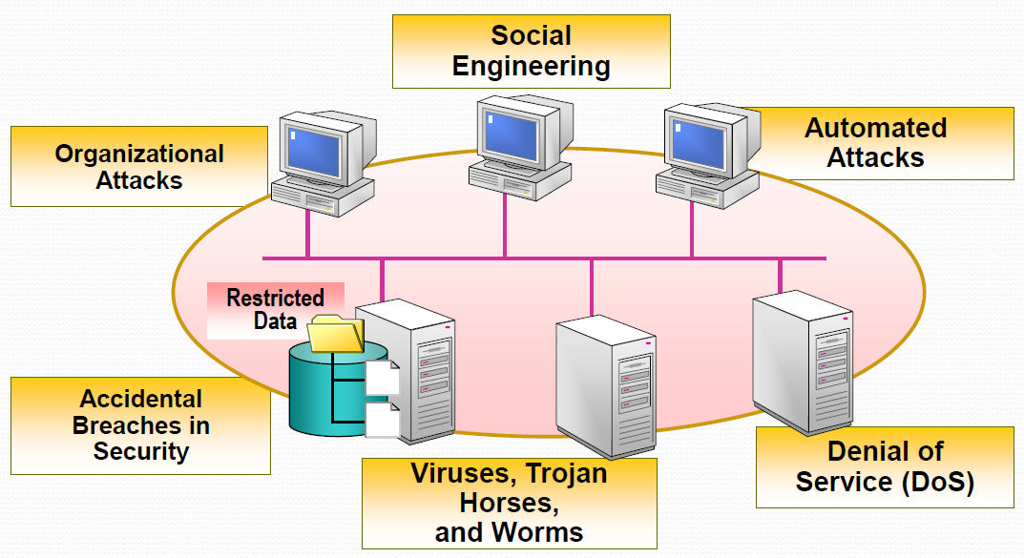
Need to Protect from Possible External Attacks

Slide 7
Skills Sets
OS: knowledge and skills in operation, configuration, management, security setting, and services.
Firewalls: configurations, and operation of intrusion detection systems.
Routers: knowledge of routers, routing protocols, and access control lists.
Mainframes: knowledge of mainframes.
Network Protocols: TCP/IP; how they function and can be manipulated.
Project Management: leading, planning, organizing, and controlling a penetration testing team.

Slide 8
Advantages
To catch a thief you have to think like a thief.
Helps in closing the open holes in the system network.
Provides security to banking and financial establishments.
Prevents website defacements.
An evolving technique.

Slide 9
Disadvantages
All depends upon the trustworthiness of the ethical hacker
Hiring professionals is expensive.

Slide 10
Future Enhancements
As it an evolving branch the scope of enhancement in technology is immense.
No ethical hacker can ensure the system security by using the same technique repeatedly.
More enhanced software’s should be used for optimum protection.

Slide 11

Any Question ?
Anything to discuss ?

Slide 12
Upaya pemerintah dalam melindungi data
Uni Eropa : GDPR (General Data Protection Regulation) -> https://gdpr-info.eu/
US (California State) : CCPA (California Consumer Privacy Act)
Indonesia terpisah dalam beberapa instrumen hukum :
Undang-Undang Nomor 11 Tahun 2008 tentang Informasi dan Transaksi Elektronik (UU ITE)
Undang-Undang Nomor 19 Tahun 2016 tentang perubahan UU Nomor 11 Tahun 2008
Peraturan Menteri Komunikasi dan Informatika Nomor 20 Tahun 2016 tentang Perlindungan Data Pribadi dalam Sistem Elektronik
Peraturan Otoritas Jasa Keuangan (OJK) Nomor 77/PJOK.01/2016 tentang Layanan Pinjam Meminjam Uang Berbasis Teknologi Informasi
PP Nomor 71 Tahun 2019 tentang Penyelenggaraan Sistem dan Transaksi Elektronik (PP PSTE)
Undang-Undang Nomor 27 Tahun 2022 tentang Perlindungan Data Pribadi (UU PDP)

Slide 13
Poin-poin penting dalam UU PDP
Definisi Data Pribadi disebutkan, setiap data tentang seseorang, baik yang teridentifikasi dan dapat diidentifikasi tersendiri atau dikombinasikan dengan informasi lainnya, secara langsung maupun tidak langsung melalui sistem elektronik dan nonelektronik. (Pasal 1)
Jenis-jenis data pribadi Ada dua jenis data pribadi, yakni data yang bersifat umum dan spesifik. (Pasal 4)
Penghapusan data pribadi Pengendali data pribadi wajib memusnahkan informasi itu jika data sudah tidak memiliki nilai guna lagi atau habis retensinya. Jika pemilik data meminta datanya dihapus, pengendali harus menghapus informasi itu. (BAB IV)
Kegagalan perlindungan data pribadi Dalam UU PDP disebutkan, jika terjadi kegagalan perlindungan terhadap data pribadi, misalnya data bocor ke pihak-pihak lain, pengendali data wajib menyampaikan pemberitahuan tertulis paling lambat 3x24 jam kepada pemilik data dan menteri atau instansi pengawas. (Pasal 46)
Sanksi pidana atas pelanggaran penggunaan data pribadi UU PDP juga mengenakan sanksi atas pelanggaran data pribadi. Pelaku yang mengungkapkan atau menggunakan data pribadi yang bukan miliknya secara melawan hukum akan dikenakan pidana penjara 4 - 5 tahun dan / atau denda maksimal mencapai Rp 60 miliar. (BAB XIV)

Slide 14
Any Question ?
Anything to discuss ?

Slide 15


